Slide 1
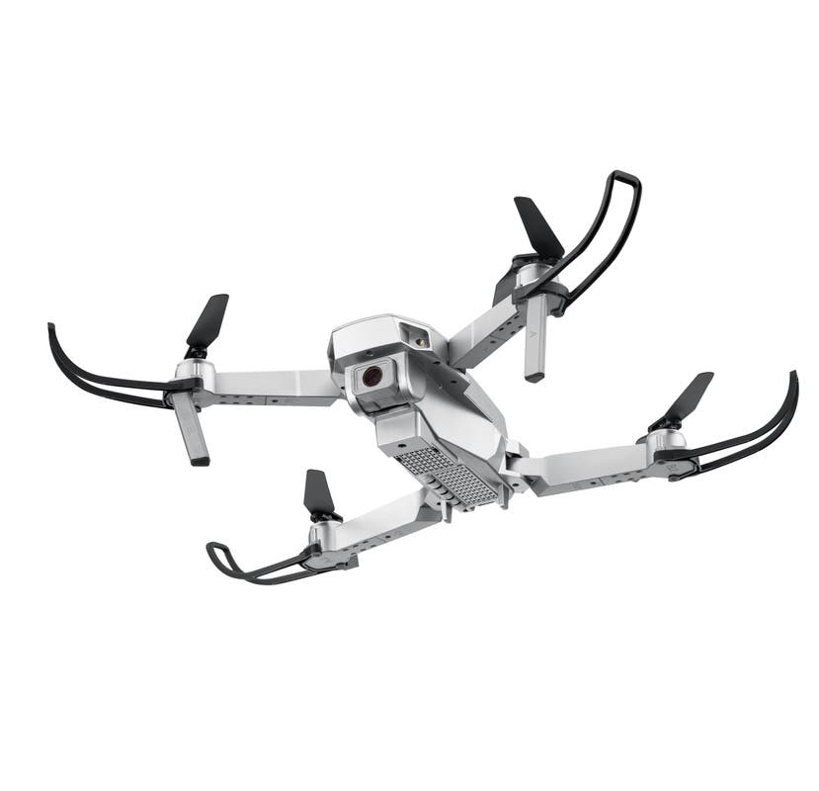
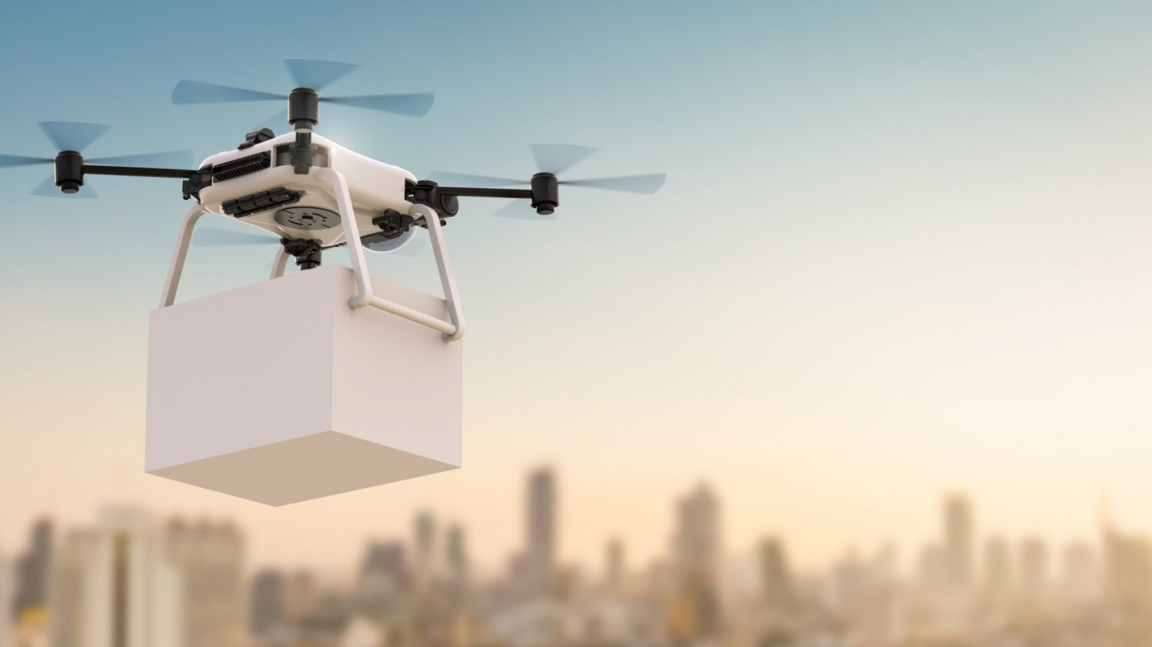
Unpiloted Delivery Drone
Task – To deliver a parcel from point A to B
Application – Quicker Delivery Service
Jonathan Edwards

